Slide 1


SHINE Virtual iHUB – Technical and Implementation Progress
Current Status and Planned Steps
Transnational Project Meeting
Ionian University · Corfu, Greece · 27–28 April 2026

Slide 2
Agenda
1. iHUB functional overview & architecture
2. Technology stack & hosting environment
3. Platform walk-through — what the iHUB looks like today
4. Teams & Organisations module
5. Public sections delivered · deployment automation
6. Roadmap — pilot testing and public launch
7. Discussion with partners

Slide 3
iHUB Functional Overview
The SHINE Virtual iHUB serves as a unified digital environment that supports collaboration, learning, and knowledge exchange within the consortium.
It is built on a hybrid architecture combining:
WordPress – the central portal for communication, resource sharing, and team management
Moodle 4.5 LTS – the Learning Management System for courses, assessments, and user progress tracking
Edwiser Bridge – the integration layer ensuring user synchronization, course enrollment, and Single Sign-On (SSO)
The platform provides structured access to learning materials, interactive simulations, and collaborative tools while remaining open for future extensions such as AI-based assistance and Metaverse integration.

Slide 4
System Architecture
WordPress
Edwiser Bridge
Moodle 4.5 LTS
Portal · Teams & Orgs · News · Resource library
User sync · SSO · Course enrollment · REST bridge
Courses · Assessments · Progress tracking · Cron jobs
Data layer: MariaDB 10.4 · separate databases for WordPress (wp_ihub) and Moodle (moodle_ihub) · utf8mb4_unicode_ci
Theme & UI: Astra 4.11 + Elementor 3.31 kit (Home, About, All Courses, Contact) · custom shine-ihub-teams plugin
WordPress ↔ Edwiser Bridge ↔ Moodle — bidirectional sync for users, roles and course enrollments.

Slide 5
Technology Stack
Layer | Component | Role
Runtime | PHP 8.2 | Execution environment for WP and Moodle
Web server | Apache 2.4 (XAMPP 8.2.12) | HTTP front-end, virtual host for ihub
Database | MariaDB 10.4 | Two schemas: wp_ihub, moodle_ihub
CMS / Portal | WordPress (latest) + Astra 4.11 | Pages, content, news, team directory
LMS | Moodle 4.5 LTS | Courses, enrollments, gradebook, quizzes
Integration | Edwiser Bridge (free) | User & course sync, SSO between WP and Moodle
Page builder | Elementor 3.31 + Header/Footer Builder | Design system and page layouts
Custom module | shine-ihub-teams (in-house plugin, v0.1.0) | Teams, Organisations, Projects, Actions, Activities
Scheduling | Windows Task Scheduler | Moodle cron every 1 minute

Slide 6
Phase 1 · Platform Setup and Configuration Test
COMPLETED
WordPress and Moodle environments deployed (test).
Edwiser Bridge installed; API communication tested successfully.
User roles, permissions, and site structure configured.
Moodle base course templates and test users created.
Visual design and navigation finalized according to project standards.
Homepage and hero section aligned with the learning-oriented identity — “Learning made easy – Your virtual learning hub.”
WordPress ↔ Moodle synchronization functional for users, roles, and course management.
Deployment reproducibility: one-command PowerShell installer (install.ps1) for XAMPP targets.

Slide 7

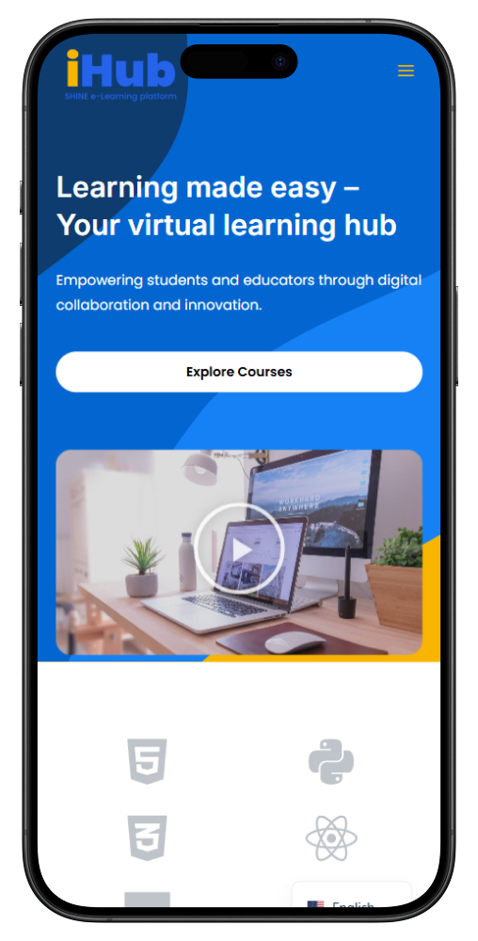
Platform Look & Feel — Home
Responsive hero section · Explore Courses CTA · video introduction placeholder.

Slide 8
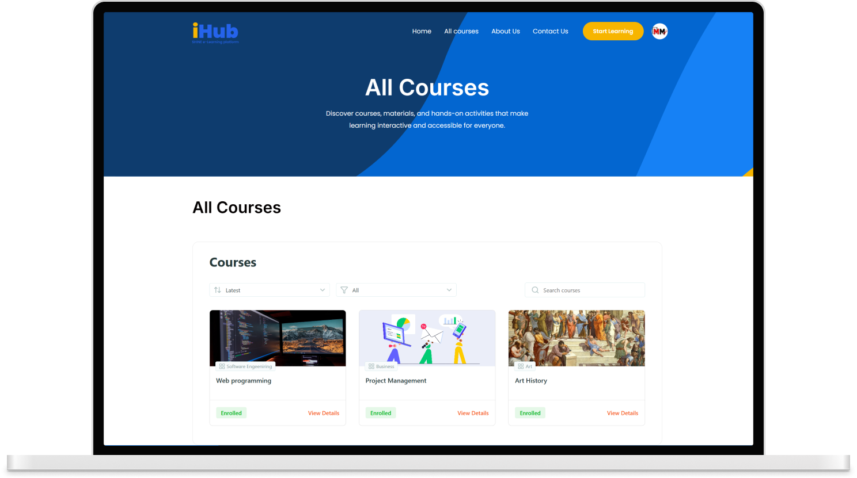
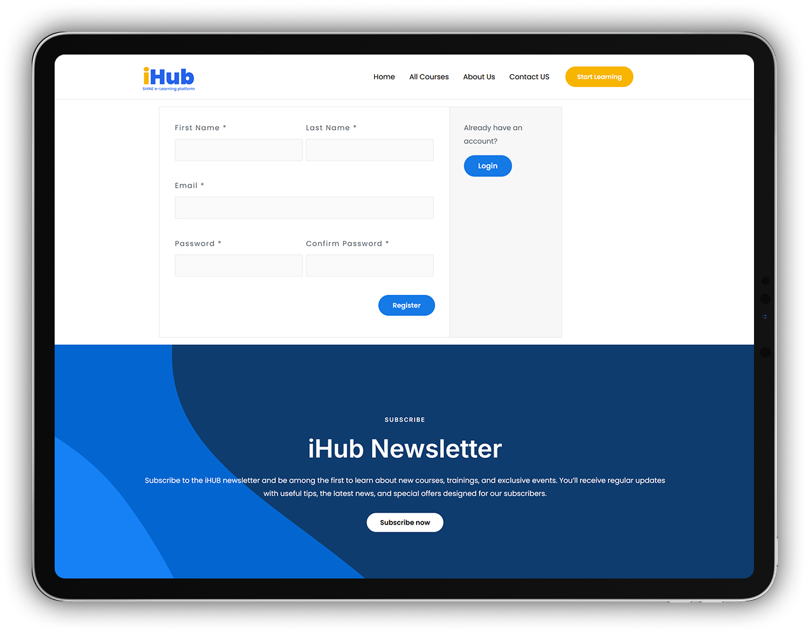
Platform Look & Feel — Courses & Registration
All Courses page (Edwiser Bridge catalog) · Registration and iHub Newsletter sign-up.

Slide 9
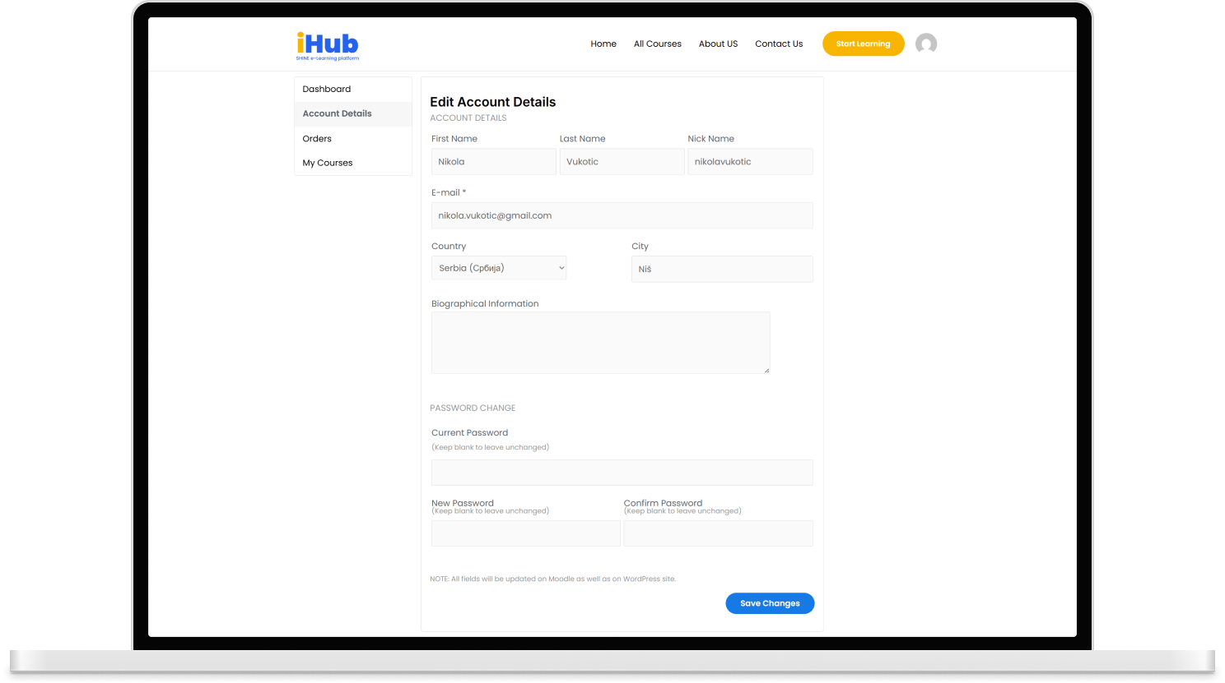
Platform Look & Feel — User Account
Edit Account Details — all fields are propagated both to Moodle and WordPress via Edwiser Bridge (SSO-aware profile).

Slide 10
Teams & Organisations Module
The consortium directory — organisations, people, teams, projects and their activities, all in one place.
Organisations
Units
People
Teams
Projects
Actions
Activities
Partner institutions
Departments & groups
Staff, mentors, students
Working groups
Joint initiatives
Planned steps
Delivered outputs
What the module delivers
Public directory pages listing partner organisations, teams, people and projects
Detail pages showing who belongs to which team, which team works on which project, which activities a project has produced
Administrative interface for each partner to manage their own entries — no developer involvement needed
Classification by organisation type, field, country and activity type for easy filtering
Open data access for dashboards, reports and external integrations

Slide 11
Public Sections Delivered
Every section the consortium agreed on is published and live on the test deployment.
Home
About Us
All Courses
Organisations
Hero, platform pitch, featured courses
Project mission, consortium overview
Edwiser-powered course catalogue
Partner institutions directory
Teams
People
Projects
Onboarding
Working groups across partners
Researchers, mentors, students
Joint initiatives and outputs
Step-by-step first-time guide
User Guides
Resource Library
Contact
Legal
Role-specific how-to articles
Teaching scenarios, templates, publications
Reach the consortium / support
Privacy Policy, Terms of Use, Cookies
Together these sections form the complete public-facing surface of the iHUB platform.

Slide 12
Deployment & Content Seeding
A partner institution can have a full, ready-to-use environment in minutes.
One-command installation — WordPress, Moodle and Edwiser Bridge are set up automatically on standard Windows / XAMPP hosting
Demo content is seeded on first run — sample organisations, teams, projects and three example courses to explore the platform immediately
Re-runnable safely — the same command can be used to refresh or re-deploy without losing existing data
Credentials and URLs are generated and saved for the administrator
Result: every partner can set up, test, and demo the platform on their own hardware without developer support

Slide 13
Phase 2 · Module Development & Content Integration
COMPLETED
November 2025 – January 2026
Teams and Organisations Management module developed and deployed
Demo organisations, teams, and project entries created for internal testing
Initial course content prepared in Moodle (Concurrent Engineering, Project Design, Methodology & Teaching)
Public-facing sections delivered — Resource Library, User Guides, Onboarding Materials
Navigation, directory pages, and legal pages (Privacy, Terms, Cookies) published
Branding aligned across SHINE and iHub visual identities

Slide 14
Phase 3 · Pilot Testing & Feedback Collection
ON TRACK
February 2026 – May 2026
Pilot users invited from partner institutions — students, mentors, and academic staff
Usability and performance testing under way on the test deployment
Feedback collected through in-platform surveys and focus groups
Reported issues being resolved and UX refinements shipped continuously
Internal progress reports delivered to consortium partners
Corfu meeting (27–28 April) — live focus group with educators and students
Feedback from the Corfu focus group will feed directly into the final refinements ahead of the June launch window.

Slide 15
Phase 4 · Final Adjustments & Public Launch
PLANNED
June 2026 – August 2026
Finalize content, branding, and legal documentation (privacy policy, terms of use)
Integrate optional external features (AI assistant, Metaverse links)
Train institutional administrators for local deployment and coordination
Performance hardening — caching, asset optimisation, uptime monitoring
Migrate from local XAMPP test host to production hosting target
Public launch announcement coordinated with dissemination partners

Slide 16
Discussion with Partners
We are on schedule for the June launch window. A few items where partner input will shape the final product:
About Us page — what information should each partner's profile include (bio, focus areas, contacts)?
Homepage introduction — would a short introductory video or presentation be useful?
Content for Organisations, Teams and People — each partner's nominated contributor to populate their entries
Pilot testing — which students, mentors, and staff should we invite for the remaining April–May round?
Thank you — questions welcome.

